Slide 1

RoadSoS
The Ultimate Offline-First Emergency Network
EMPOWERING ACCIDENT VICTIMS & BYSTANDERS DURING THE GOLDEN HOUR
NATIONAL ROAD SAFETY HACKATHON 2026 | TEAM LifeLane

Slide 2

THE PROBLEM
Golden Hour Delays Cost Lives on Highways
Highway emergency response rates are critical. Survival rates drop by 60% for every 10-minute delay during the 'Golden Hour' (first 60 mins):
Traditional calling applications, medical guidance databases, and maps depend heavily on stable high-speed cellular networks. On critical highway segments, this reliance introduces single-points-of-failure.
📶 Cellular Dead Zones (OSM Data)
Over 40% of national highway corridors pass through cellular coverage gaps or dead zones. Standard API-based apps (like Google Maps or Uber) stall immediately with zero bars of signal.
🧠 Victim Trauma & Bystander Panic
Victims suffer physical shock, limiting phone interaction. Bystanders, driven by panic, fail to communicate GPS coordinate metrics or recall regional emergency helpline directories.

Slide 3

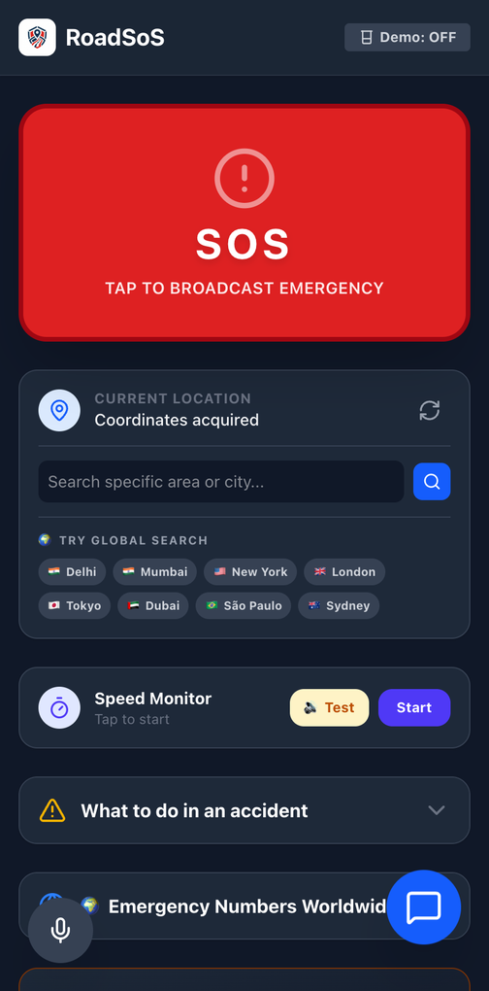
OUR SOLUTION
Autonomous, Offline-First Rescue Ecosystem
RoadSoS is an offline-first PWA that bypasses cellular dependence to ensure continuous safety backup:
🌐 IndexedDB Spatial Caching
Uses Dexie.js to store over 1,500+ regional hospital coordinates, pharmacy locations, and local police helpline directories on client storage. Geolocation signals map directions offline.
📱 Zero Installation Footprint
Progressive Web App (PWA) boot speeds complete in <1.5 seconds. Instantly accessible via SMS web links or vehicle QR code stickers without app store downloads.

Slide 4

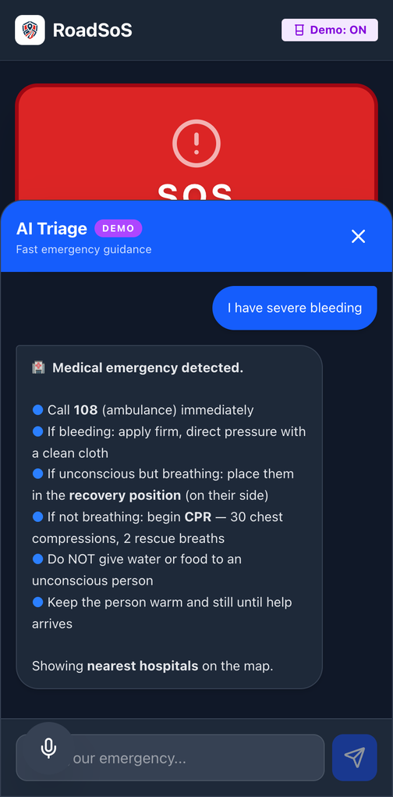
CORE ENGINE
Hardware SOS Blackbox & AI Safety Copilot
Dual-Shield Safety Protocols
Combines real-time proactive driver speed safety alerts with autonomous reactive triggers:
🔊 Audio Siren wave
Generates raw 440Hz sawtooth frequencies using Web Audio API to alert nearby rescuers in dark conditions.
🎙️ Forensic Recorder
Local MediaRecorder saves 15 seconds of accident audio logs directly to browser indexed storage.
📳 Impact Shake Detect
Uses device accelerometer filters to detect structural G-force and auto-dial 112 emergency numbers.
⚡ GPS Speed Monitor
Watches speed velocity via Geolocation API, flashing warning lights and alert buzzers to check limits.
📝 Report Generator
Instantly packs lat/lng coordinates, address descriptors, and audio links into text reports.
📍 Hotspot Map Alerts
Pre-loads accident-prone blackspot coordinates, warning driver upon zone entry offline.

Slide 5



TECHNICAL STACK
Resilient System Architecture Layers
1. Client Frontend
2. Offline Guard
3. Integration APIs
• React + Vite Framework: Single Page Application layout boots in milliseconds.
• PWA Service Worker: Caches main application shell and scripts via Workbox.
• OpenStreetMap API: Fetches raw public spatial data for emergency services.
• Tailwind CSS: Dark-mode interface optimized for outdoor high-glare and night emergency visibility.
• IndexedDB Database: Handles regional hospital listings, police caches, and map files local queries.
• Claude LLM: Parses complex symptoms and multilingual questions when online.
• Leaflet.js Mapping: Implements canvas-based offline tile render hooks.
• Local Rule-Engine: Chatbot runs on-device rule matching for first-aid without internet.
• Hardware Sensor APIs: Binds Accelerometer, AudioContext, and Media Recording tools.

Slide 6



THE IMPACT
Scalable, Zero Cost, Lifesaving Platform
$0
100%
Instant
Map API Licensing Fees
Commercial maps cost $7 per 1,000 lookups. RoadSoS leverages free OpenStreetMap datasets and local cache indexing. This design eliminates runtime overheads, allowing global scaling at zero platform fees.
Universal Location Coding
OSM maps cover all roads, toll plazas, and emergency centers globally. The app matches coordinate boundaries locally in any country (e.g. India, EU, US), updating emergency contact numbers dynamically.
Offline Zero-Bar Access
In trauma situations, installation delays lead to negative outcomes. PWA formats boot directly in mobile browsers. Essential siren systems, GPS alerts, and first-aid run with zero network active.

Slide 7

Thanks
Let's make our highways safer, together.
📱 Try RoadSoS Live Demo
Instant loading, offline cached PWA ready for tests.
LIVE REPOSITORY: https://github.com/naithanianuj68-glitch/RoadSos

